Slide 1


Front end
(Introduction to css)
Lecture-12( Part 1)

Slide 2

Today’s Agenda
Inheritance In CSS
CSS Units
Absolute v/s Relative Units
Styling Background Using CSS

Slide 3
Inheritance In CSS
Inheritance is a process of receiving values of properties by a child element from its parent element.
Each element in an HTML document is part of a tree, and every element except the initial <html> element has a parent element that encloses it.
Whatever styles are applied to that parent element can be applied to the elements enclosed in it if the properties are inherited.

Slide 4
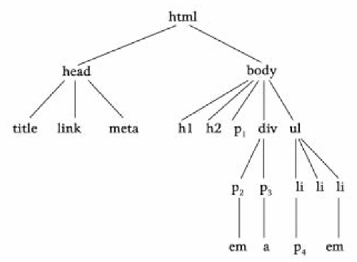
HTML Inheritance Tree

Slide 5
Inheritance In CSS
Not all properties are inherited .
For example , font-size is inherited but border is not inherited.
For a complete list of inherited/non inherited properties we can refer to the link:
https://www.w3.org/TR/CSS22/propidx.html

Slide 6
The inherit Keyword
The inherit keyword allows us to explicitly specify inheritance.
It works on both inherited and non-inherited properties.
Example:
h1 {
border: solid 2px red;
}
em {
border: inherit;
}

Slide 7
CSS Units
A CSS unit determines the size of a property we’re setting for an element or its content.
For example, if we wanted to set the property margin of a paragraph, we would give it a specific value.
This value includes the CSS unit.

Slide 8
CSS Units
Let’s look at a small example:
p {
margin: 20px;
}
In this case:
margin is the property
20px; is the value, and
px (or “pixel”) is the CSS unit.

Slide 9
Two Categories Of Units
Before we can understand more about CSS units , it’s important to consider the two categories of units:
These are:
absolute
relative

Slide 10
Absolute Units
Units that are “absolute” are the same size regardless of the parent element or device size.
This means a property set with a value that has an absolute unit will always stick to that size when looked at on a phone or on a laptop or on a large screen.

Slide 11
Absolute Units
Absolute Unit | Description | Example
px | 1/96 of 1 inch (96px = 1 inch) | font-size: 12px;
pt | 1/72 of 1 inch (72pt = 1 inch) | font-size: 12pt;
pc | 12pt = 1pc | font-size: 1.2pc;
cm | centimeter | font-size: 0.6cm;
mm | millimeter (10 mm = 1 cm) | font-size: 4mm;
in | inches | font-size: 0.2in;

Slide 12
Example
h1 {
font-size: 1in;
}
h2 {
font-size: 0.5in;
}
p
{
font-size: 0.2in;
line-height: 0.5in;
}

Slide 13
Relative Units
Relative measurements have no fixed, specific value.
Instead, they are calculated in comparison to an inherited value.
Relative units are useful for styling responsive sites because they scale relative to the parent or window size (depending on the unit).

Slide 14
Relative Units
Relative Unit | Description
% | Relative to the parent element’s value for that property
em | Relative to the current font-size of the element
rem | Relative to the font-size of the root (e.g. the <html> element). “rem” = “root em”
ch | Number of characters (1 character is equal to the width of the current font’s 0/zero)
ex | Relative to height of the current font’s lowercase “x”.

Slide 15
Example
.child
{
margin: 10%;
}
We want a child element to have 10% of the parent’s width as a
margin so it never fills the whole parent element.
If the parent’s size changes, the margin will update too.

Slide 16
Example
.child
{
font-size: 0.5em;
}
We want the font of a child element to be half the size of its
parent’s font-size

Slide 17
Example
.header
{
font-size: 2rem;
}
We want the font-size to be twice the size as the root i.e <html>
element’s font.

